Slide 1
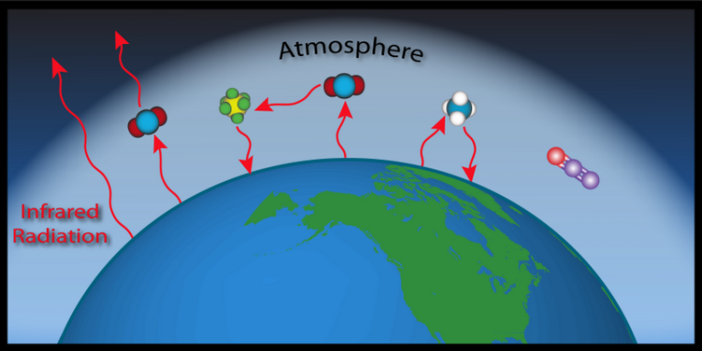
Green House Gases:
Absorption & Emission of EM radiation

Slide 2
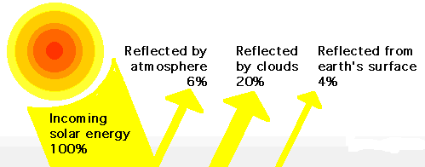
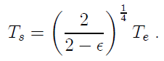
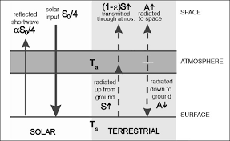
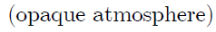
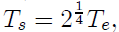
Albedo = reflected light
α = 30%
Leaky Green House Layer:
T = 303⁰k
Real situation:
Partial transparency of IR radiation or leaky green house effect
For ε= 0.78 , T_{s}=1.131T_{e}=288⁰k

Slide 3
Gases Composition of Earth’s Atmosphere:
78% nitrogen
20.6% oxygen
< 1% argon
traces gases:
Ne, He, Kr, H, O₃
Methane, Nitrous Oxide
Non-Green House Gases
0.4% water vapor,
0.036% carbon dioxide
Methane, Nitrous Oxide
Green House Gases
On what basis?????

Slide 4
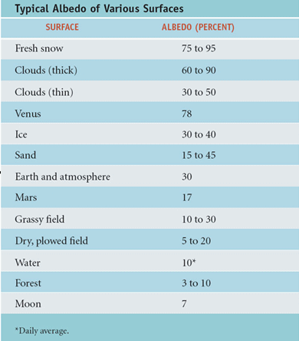
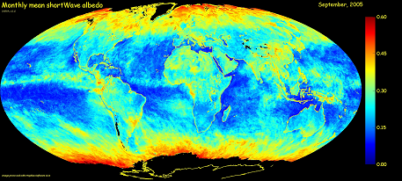
Global average ~30%
Albedo increases with latitude
Oceans are quite dark (low reflectivity)

Slide 5
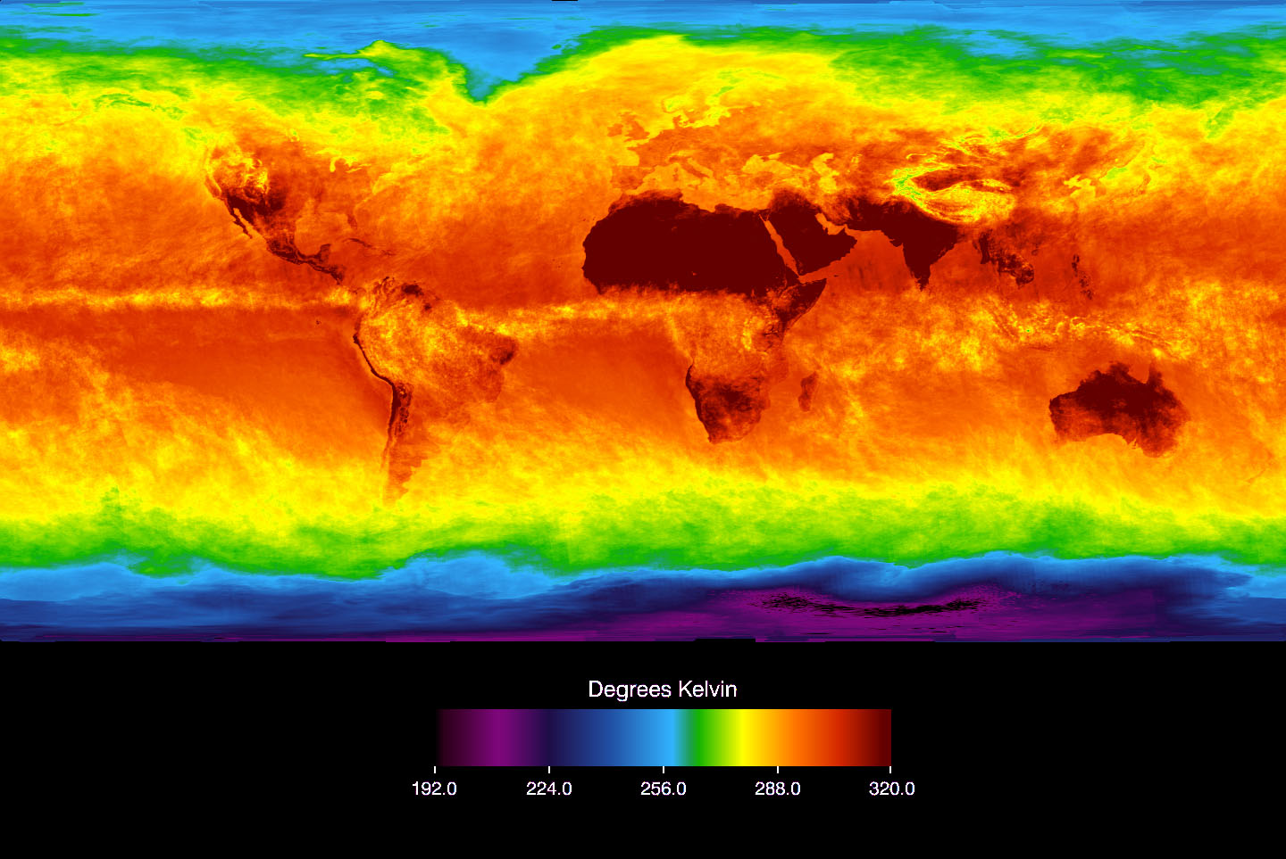
How do we get these temperatures?
-Infrared temperatures from Aqua satellite, April 2003.

Slide 6
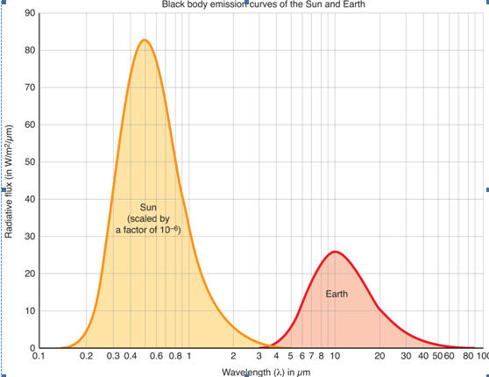
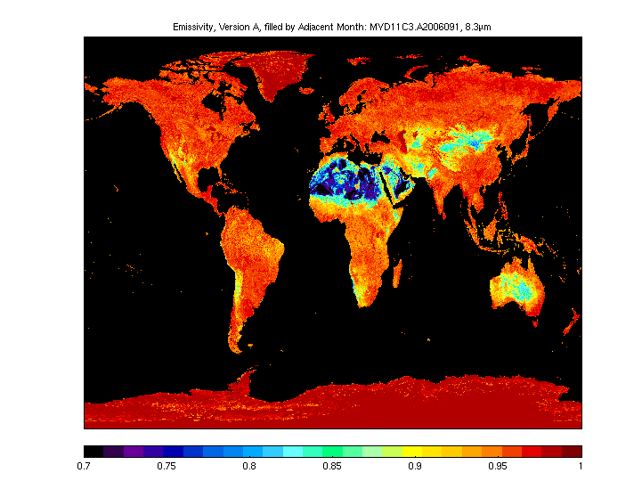
Emissivity of infrared radiation at the surface
cimss.ssec.wisc.edu/iremis/
Emissivity, ε, is a measure of how well blackbody radiation is obeyed:
F=εσT⁴
Emissivity/absorptivity is close to 1.
This implies a good approximation to black body in the infrared

Slide 7
A key fact for Earth’s climate is that how gases interact with EM radiation…
Molecules absorb radiation at particular wavelengths, depending on amount of energy required to cause vibration or rotation of atomic bond.
Two essential things for the greenhouse effect:
The Earth’s atmosphere is mostly transparent to visible radiation (why not totally)
The Earth’s atmosphere is mostly opaque to infrared radiation.
Still why only some gases are Green House Gas??
Notes:
You are all familiar with this because you know that in a microwave oven, only water molecules vibrate in response to microwaves. Most of the molecules in the food you are trying to heat are two large to respond to this particular wavelength of light.
Size of molecules….
or excitation of electrons.
O₃ absorbs radiation near 10 μm
CO₂ absorbs radiation near 15 μm

Slide 8
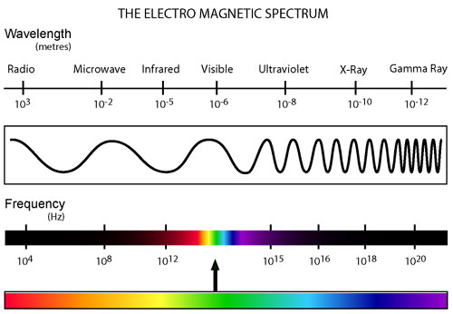
Energy Transfer by Radiation
Radiation and Greenhouse Effect
A significant section with many new physics concepts:
Spectrum
Temperature means
→atoms jiggle
→electrons jiggle
→ accelerating charges
→ electromagnetic radiation
Freq, wavelength
Energy, power
Increasing frequency
Decreasing wavelength
Increasing energy
E=hν = hc/λ
Notes:
How to explain why hot objects give off electromagnetic radiation.
Frequency and wavelength, but not wave equation

Slide 9
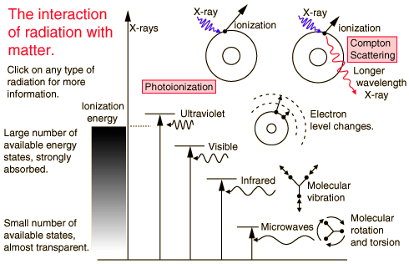
Interaction of radiation with matter
Wavelength
If there are no available quantized energy levels matching the quantum energy of the incident radiation, then the material will be transparent to that radiation

Slide 10
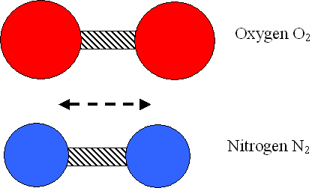
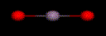
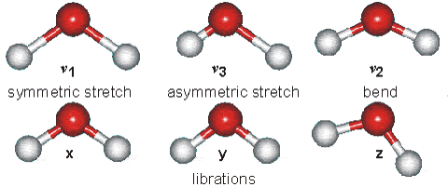
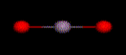
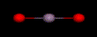
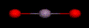
Internal energy
H₂O
CO₂
Notes:
Animations of modes of vibration of water and carbon dioxide molecules.

Slide 11
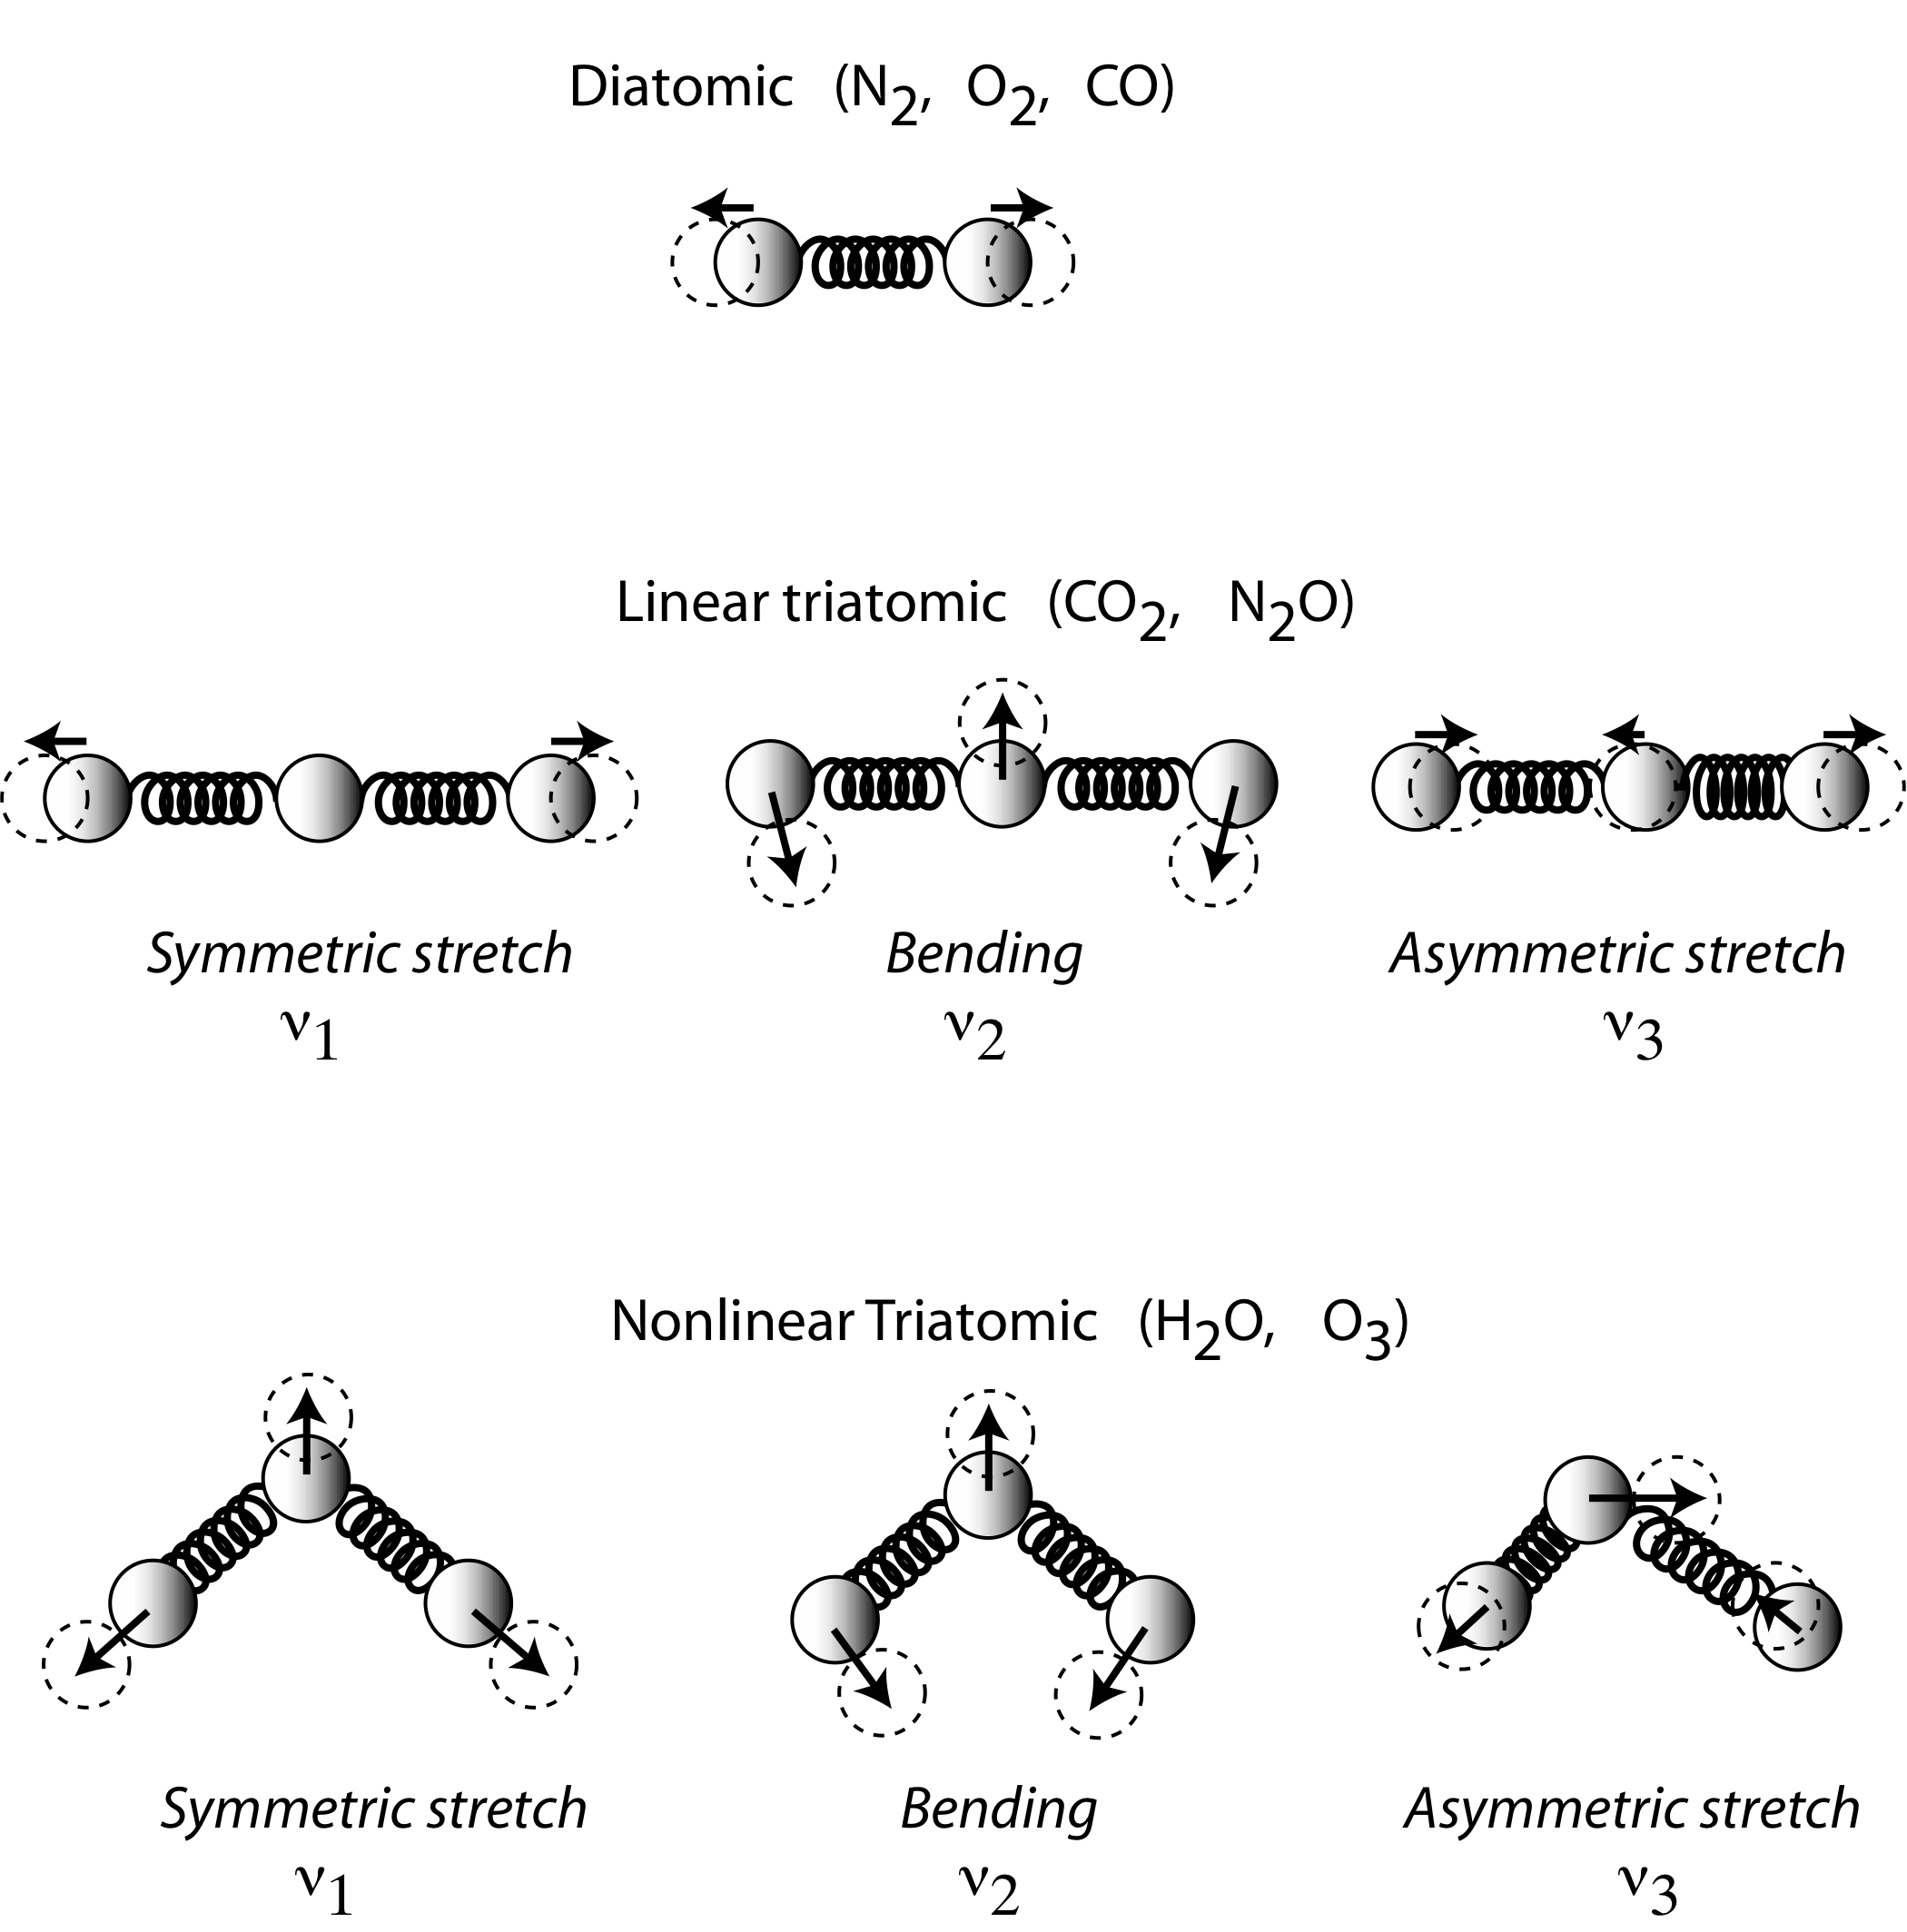
Vibration modes of simple molecules
Fundamental or normal modes
Symmetric stretch
Bend (Scissoring)
Asymmetric stretch
A normal mode is IR-active if the dipole moment changes during mode motion.
Overtones, combinations and differences of fundamental vibrations are also possible (e.g., 2v₁, v₁+v₃ etc.)
A non-linear molecule of N atoms has 3N-6 normal modes of vibration; a linear molecule has 3N-5.

Slide 12
Vibration modes of simple molecules
Fundamental or normal modes
Symmetric stretch
Bend (Scissoring)
Asymmetric stretch
Overtones, combinations and differences of fundamental vibrations are also possible (e.g., 2v₁, v₁+v₃ etc.)
A non-linear molecule of N atoms has 3N-6 normal modes of vibration; a linear molecule has 3N-5.

Slide 13
Absorption frequency for a diatomic molecule
m₁, m₂ = atomic mass of vibrating atoms
c = speed of light [3×10⁸ m s⁻¹]
V = wavenumber [cm⁻¹]
A_{v} = Avogadro’s number [6.023×10²³ atoms mole⁻¹]
k = force constant (bond strength) [dynes cm⁻¹]
For a single bond, k = 5×10⁵ dynes cm⁻¹
For a double bond, k = 10×10⁵ dynes cm⁻¹
For a triple bond, k = 15×10⁵ dynes cm⁻¹

Slide 14
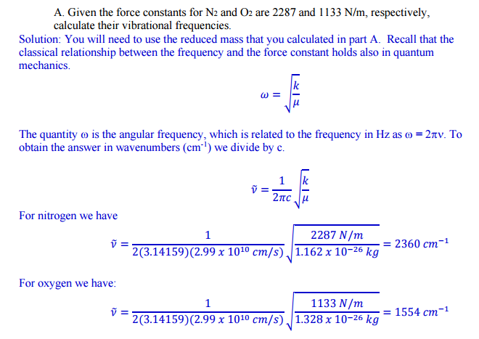

Slide 15
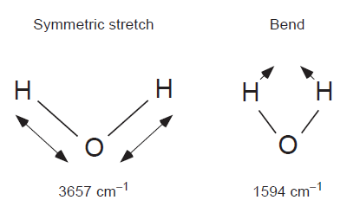
H₂O
CO₂
Notes:
Animations of modes of vibration of water and carbon dioxide molecules.

Slide 16
Infrared (IR) interactions
Region | Wavelength [µm] | Energy [meV] | Wavenumber [cm⁻¹] | Type of excitation
Far IR | 50 - 1000 | 1.2 - 25 | 10 – 200 | Lattice vibrations, Molecular rotations
Mid IR | 2.5 - 50 | 25 - 496 | 200 - 4000 | Molecular vibrations
Near IR | 1 - 2.5 | 496 - 1240 | 4000 - 10000 | Overtones
Oxygen: 1554
Nitrogen: 2360
CO2: 1340, 2350
H2O: 1554, 3657,

Slide 17
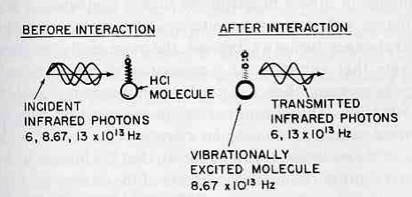
Quantum mechanics: The frequency (ν) depends on the energy gap between vibrational levels
E = hν = hc/λ (cm⁻¹)
Only the natural frequency will be absorbed
The natural frequency (8.67 x 10¹³ s⁻¹) is absorbed selectively

Slide 18
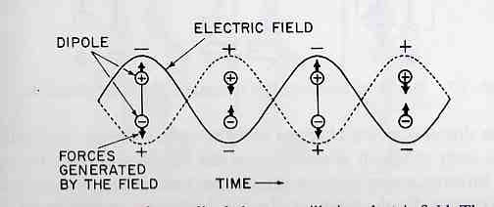
What does the absorption intensity depend on?
The absorption intensity depends on how efficiently the energy of an electromagnetic wave of frequency ν can be transferred to the atoms involved in the vibration
The greater the change in dipole moment during a vibration, the higher the intensity of absorption of a photon

Slide 19
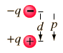
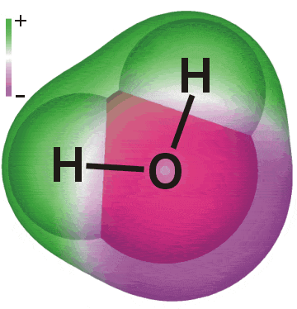
Molecular dipole moments
For a molecule to absorb IR radiation it must undergo a net change in dipole moment as a result of vibrational or rotational motion.
The electric dipole moment for a pair of opposite charges of magnitude q is the magnitude of the charge times the distance between them, with direction towards the positive charge.
The total charge on a molecule is zero, but the nature of chemical bonds is such that positive and negative charges do not completely overlap in most molecules. Such molecules are said to be polar because they possess a permanent electric dipole moment.
Water is a good example of a polar molecule:
Molecules with mirror symmetry like oxygen, nitrogen and carbon dioxide have no permanent dipole moments.

Slide 20
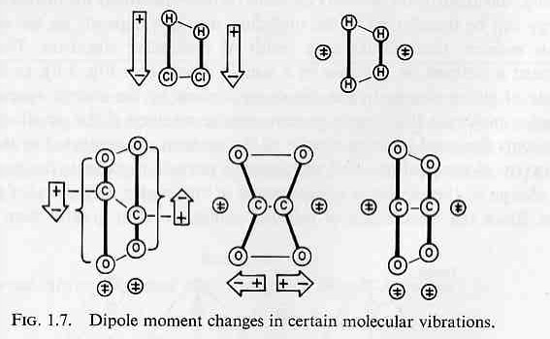
Dipole Moment Must Change during for a vibration to be “IR active”!
In order to interact strongly with the EM radiation, the motion of the molecule must be such that the dipole moment changes.
Which of the vibrations are “IR” active”?

Slide 21
What is the intensity of an IR signal of:
O₂ or N₂ or H₂?
Ans: In order to absorb infrared radiation, a molecular vibration must cause a change in the dipole moment of the molecule
O₂, N₂ and H₂ DO NOT ABSORB IR LIGHT!
The are not “Greenhouse” gases

Slide 22
the dipoleaverage upper and lower state electric s are equal (there is no rule stating that has to be true).What you are really trying to say is that the molecule must at the very least have a temporary dipole and the max/min dipoles between the two states will change (due to the max/min distance change in a harmonic osscilator) .
Its this dipole that allows the electric field of the molecule and light wave to interact (more specifically the transition dipole but that has other weighted factors beyond the
pure electric dipole). For example CO would have a permanent dipole and no mode would induce an average change to this dipole. Something like CH4, which is symmetrical, has an induced dipole with asymmetric stretching and bending modes (or in very high J states)
where as N2 has no asymmetric modes and will maintain
an exactly equal electronic gradient at any separation.

Slide 23
The ability of a compound to absorb IR energy depends on a net change in the dipole moment occurring when the molecule vibrates. Whether or not such a change occurs depends on the distribution of electrical charges in the molecule.
The carbon monoxide molecule can be thought of as a carbon atom joined to an oxygen atom by means of a compressible bond. The carbon has six electrons surrounding its nucleus and oxygen has eight. During a vibration a change in the charge distribution occurs, this appears to the incident IR radiation as an oscillating charge. It is this oscillating charge that the light interacts with.
When the frequency of the radiation matches the frequency of the oscillating charge the IR radiation is absorbed. Consequently, carbon monoxide shows an absorption band in the IR region at the frequency corresponding to the vibrational frequency of the nuclei. There is no net change in the dipole moment during the vibration of homonuclear molecules such as O2, N2, and H2, and these molecules do not absorb IR radiation. The ability of a molecule to absorb radiation during a particular vibration depends on its electrical geometry."

Slide 24
Photons, including infrared photons, are of course a form of electromagnetic radiation. As such, they can also be understood as disturbances, or waves, of electromagnetic energy. Atoms, and the molecules they combine to form, have electrically charged particles (electrons and protons) in them
The gas molecules we are currently considering, nitrogen and oxygen and the various GHGs, have no net charge; they have equal numbers of electrons and protons. However, molecules that are on average neutral (in terms of their electrical charge) can still have localized charges, either some of the time (when they are vibrating) or all of the time.
For example, surface tension in water is caused by the tendency of water molecules to stick together because the electrons that the oxygen and hydrogen atoms share are not shared equally. The shared electrons spend more time closer to the oxygen atom's nucleus, which has more protons and thus pulls on the electrons more strongly. The portion of each water molecule that is near the oxygen atom has a negative charge (excess electrons), while the areas around the two hydrogen atoms have positive charges (fewer electrons to offset the protons). Water molecules have localized areas of positive and negative charges, so individual water molecules tend to "stick" to one another (the positive hydrogen segments being attracted to the negative oxygen portion).
Molecules are not, however, rigid ball and stick figures as our chemistry class models may lead us to believe. Molecules are in motion; continuously bouncing around and jiggling and vibrating. Consider first a diatomic nitrogen (N₂) or oxygen (O₂) molecule. A pair of balls attached by a spring is a good model of such a molecule. Pull the balls apart and release them; they alternately move closer together and further apart. This vibrational mode is extremely symmetric, however; the center of mass of the system always remains at the point midway between the two balls/atoms. Electromagnetic "disturbances" (waves) do not tend to interact with, or transfer energy to, such diatomic molecules (such as N₂ or O₂)

Slide 25
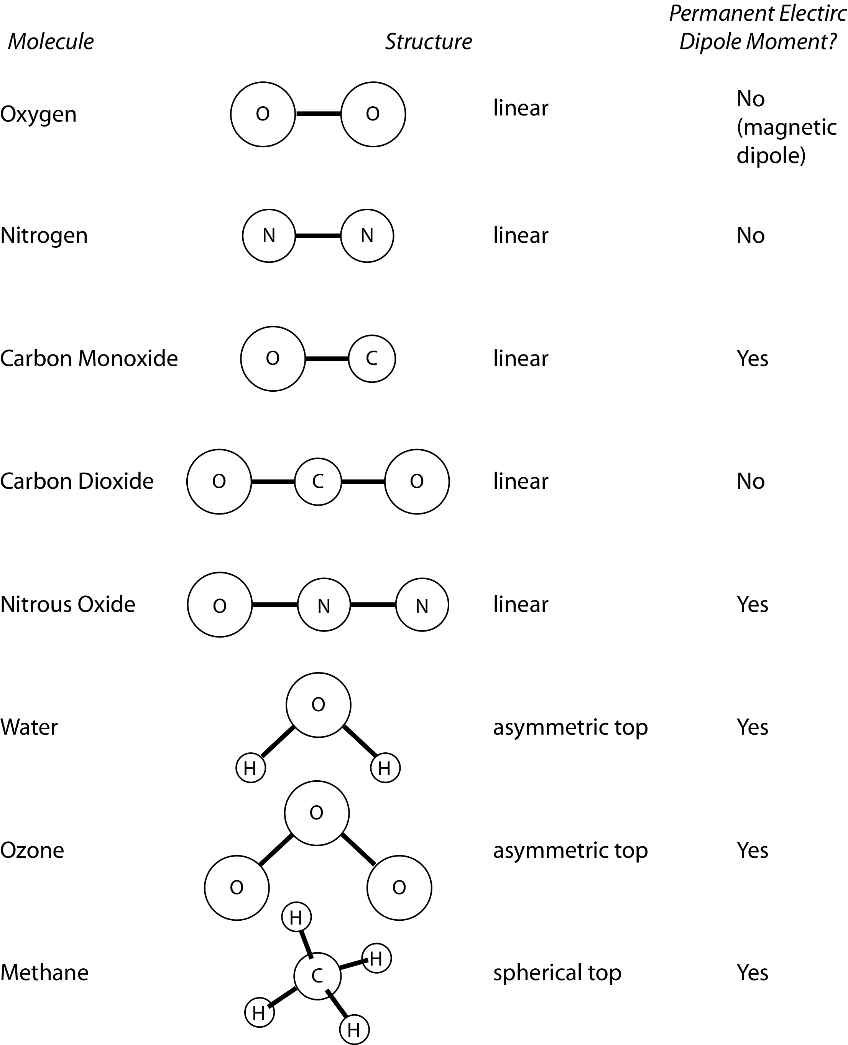
Key atmospheric constituents
Diatomic, homonuclear molecules (e.g., N₂, O₂) have no permanent electric dipole moment (also CO₂)
Molecular N₂, the most abundant atmospheric constituent, has no rotational absorption spectrum
Oxygen (O₂) has rotational absorption bands at 60 and 118 GHz
Linear and spherical top molecules have the fewest distinct modes of rotation, and hence the simplest absorption spectra
Asymmetric top molecules have the richest set of possible transitions, and the most complex spectra
Note lack of permanent electric dipole moment in CO₂ and CH₄
No

Slide 26
Infrared (IR) interactions
Vibrational transitions are associated with larger energies than ‘pure’ rotational transitions.
Vibrations can be subdivided into two classes, depending on whether the bond length or angle is changing:
Stretching (symmetric and asymmetric)
Bending (scissoring, rocking, wagging and twisting)
Stretching frequencies are higher than corresponding bending frequencies (it is easier to bend a bond than to stretch or compress it)
Bonds to hydrogen have higher stretching frequencies than those to heavier atoms.
Triple bonds have higher stretching frequencies than corresponding double bonds, which in turn have higher frequencies than single bonds

Slide 27
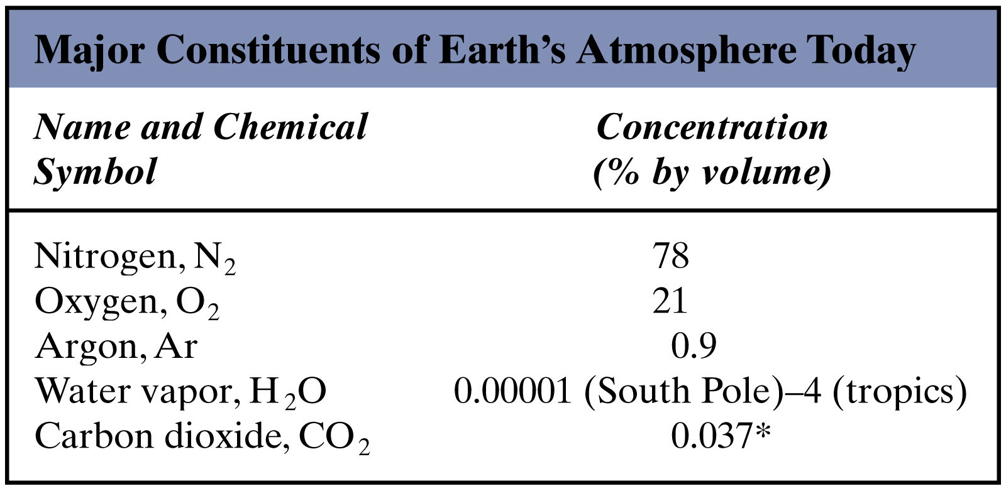
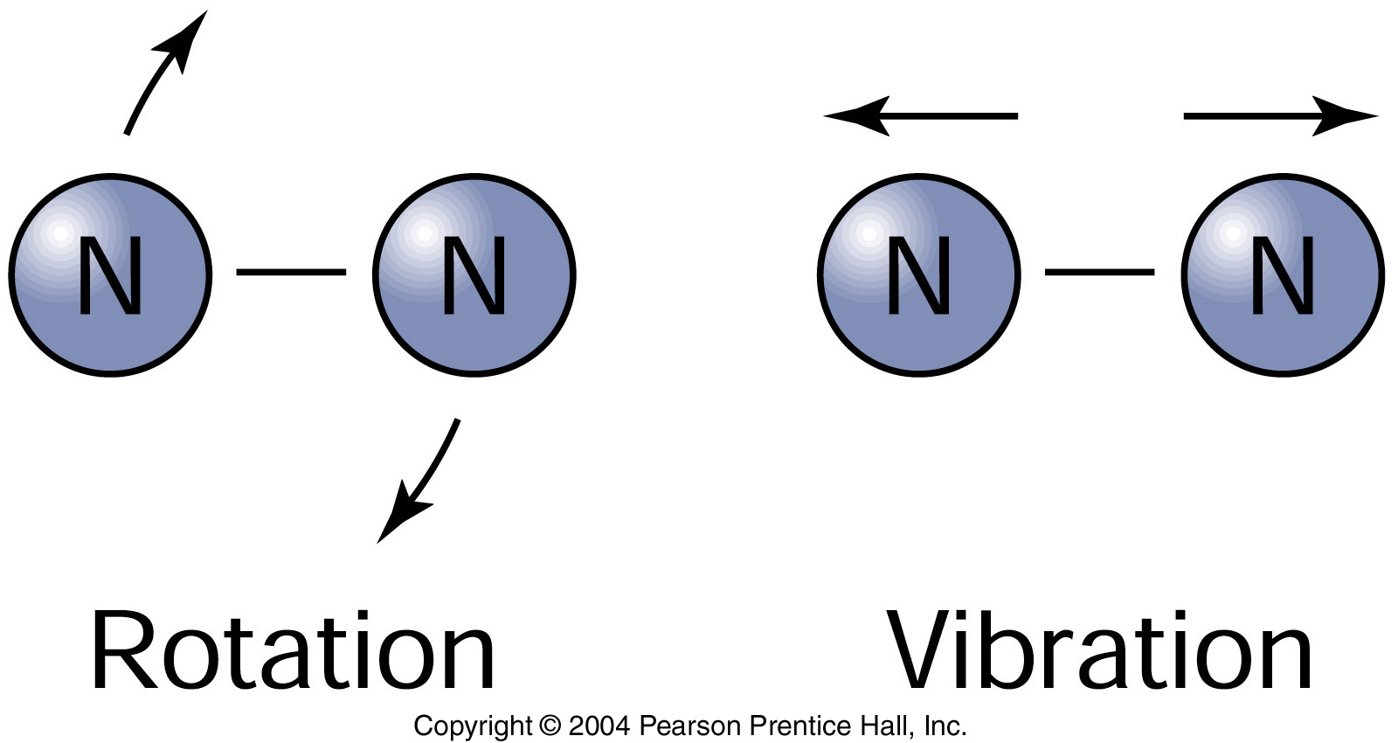
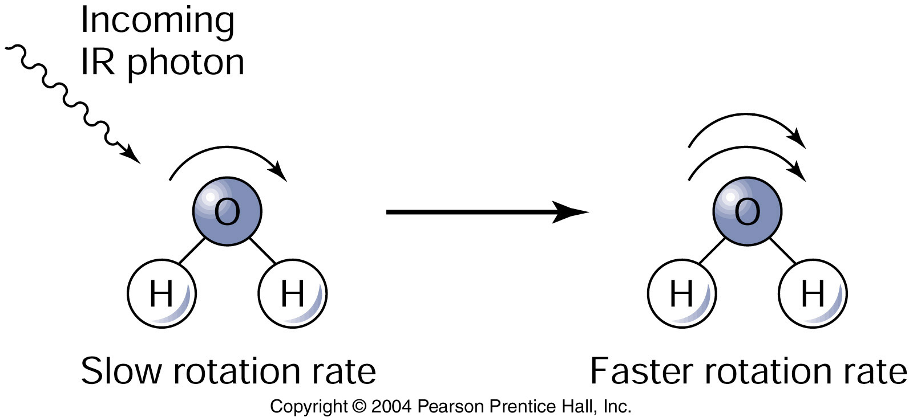
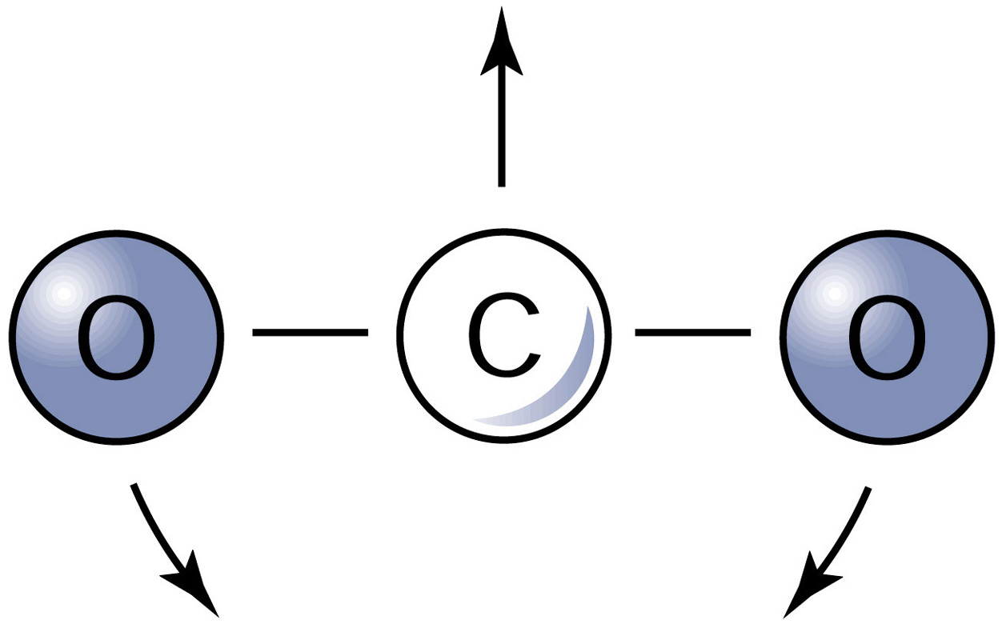
The composition of the Earth’s atmosphere matters...
(Plus other trace components, e.g. methane, CFCs, ozone)
Bi-atomic molecules (O₂, N₂) can only absorb
high energy photons, meaning ultraviolet
wavelengths and shorter.
Tri-atomic molecules (H₂O, CO₂) can absorb
lower energy photons, with wavelengths in the
infrared

Slide 28
Carbon dioxide (CO₂)
Linear → no permanent dipole moment, no pure rotational spectrum
Fundamental modes:
The v₃ vibration is a parallel band (dipole moment oscillates parallel to symmetric axis), transition ΔJ = 0 is forbidden, no Q branch, greater total intensity than v₂ fundamental
The v₂ vibration is perpendicular band, has P, Q, and R branch
The v₃ fundamental is the strongest vibrational band, but the v₂ fundamental is most effective due to “matching” of vibrational frequencies with terrestrial Planck emission function
¹³C isotope (1% of C in atmosphere) and ^{17/18}O isotope (0.2%) cause a weak splitting of rotational and vibrational lines in the CO₂ spectrum
o
c
o
symmetric stretch
v₁ = 7.5 μm => IR inactive
asymmetric stretch
v₃ = 4.3 μm
bend
v₂ = 15 μm
bend v₂

Slide 29
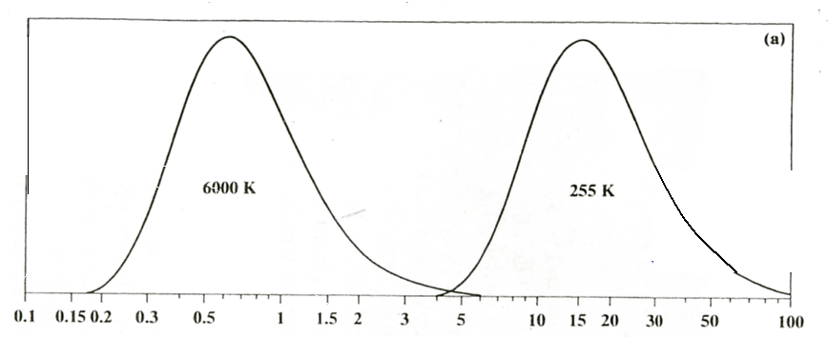
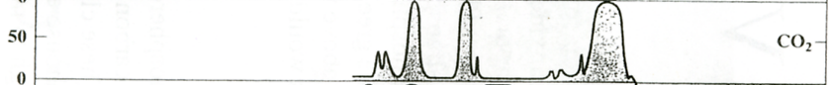
Carbon dioxide (CO₂)
Linear → no permanent dipole moment, no pure rotational spectrum
Fundamental modes:
o
c
o
symmetric stretch
v₁ = 7.5 μm => IR inactive
asymmetric stretch
v₃ = 4.3 μm
bend
v₂ = 15 μm
bend v₂
IR Absorption Spectrum of CO₂

Slide 30
Water vapor (H₂O)
Most important IR absorber
Asymmetric top → Nonlinear, triatomic molecule has complex line structure, no simple pattern
3 vibrational fundamental modes
o
H
H
o
symmetric stretch
v₁ = 2.74 μm
bend
v₂ = 6.25 μm
asymmetric stretch
v₃ = 2.66 μm

Slide 31
Nitrous oxide (N₂O)
Linear, asymmetric molecule (has permanent dipole moment)
Has rotational spectrum and 3 fundamentals
Absorption band at 7.8 μm broadens and strengthens methane’s 7.6 μm band.
4.5 μm band less significant as it is at the edge of the Planck function.
Fundamental modes:
O
N
N
symmetric stretch
v₁ = 7.8 μm
asymmetric stretch
v₃ = 4.5 μm
bend
v₂ = 17.0 μm
bend v₂

Slide 32
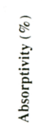
IR Absorption Spectrum of N₂O
v₃=4.5 µm
v₁=7.8 µm
v₂=17 µm

Slide 33
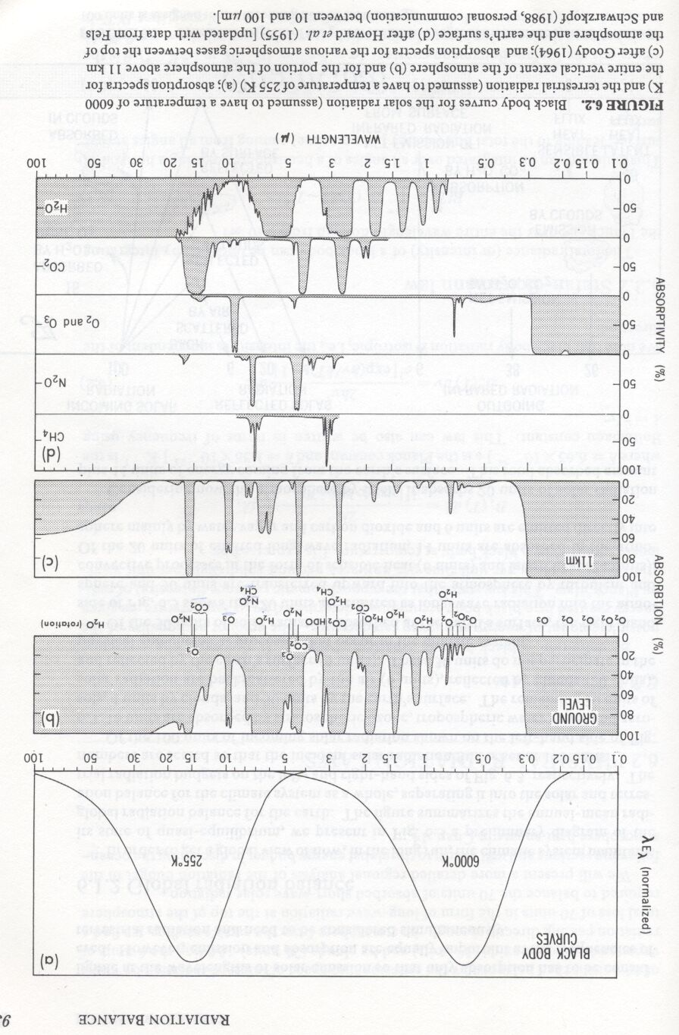
Atmospheric absoption by atmospheric constituents
solar &
terrestrial
emissions
as a function
of wavelength
100%-
CH₄
N₂0
O₂,0₃
CO₂
H₂0
0%-
Peixoto and Oort, 1992

Slide 34
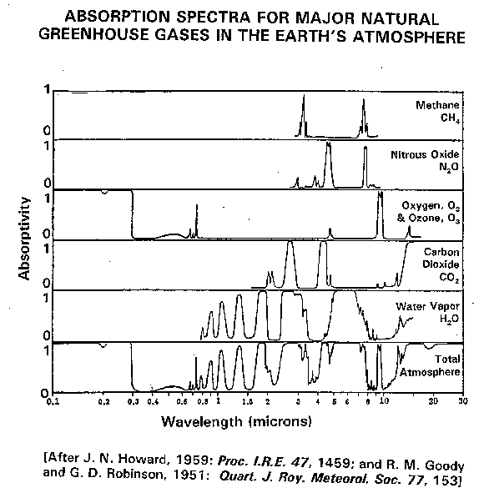
Absorptivity is very low or near zero in atmospheric window

Slide 35
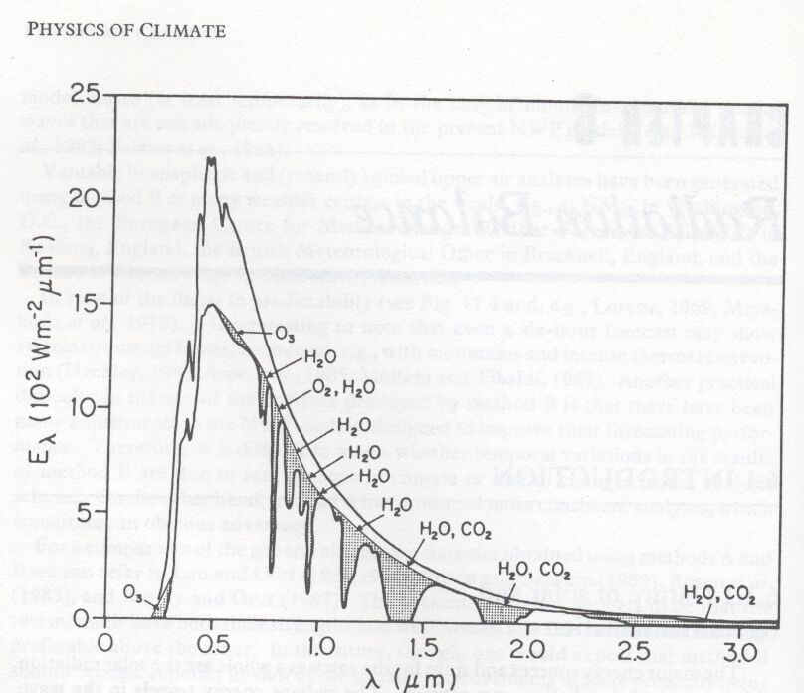
Atmospheric absorption
Shortwave (i.e. solar) radiation measured from the top of
atmosphere and from the ground.
The (clear) atmosphere is not totally
transparent to solar radiation:
back scatter by dust, aerosols
absorption by constituent gases
amount varies as a function of
wavelength
Peixoto and Oort, 1992

Slide 36
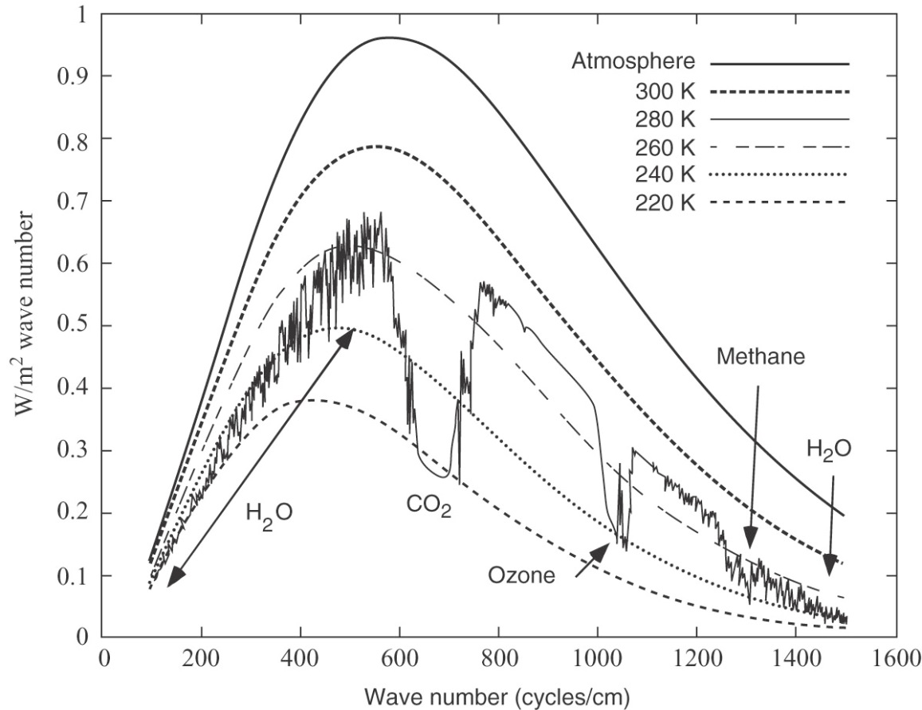
How gh gases interact with IR (page 32)
Gases are not good blackbodies!
Very choosy about what wavelengths they absorb and emit.
Blackbody spectra for Earth - T ranges from hot summer day to cold upper atm (model generated data)
Jagged curve – IR light measured by a spectrophotometer looking down
CH₄ – 1300 cycle/cm (8 μm)
CO2 effects outgoing IR more because there’s more IR energy at 700 cycle/cm (14 μm)
50 μm
14 μm
10 μm
7.0 μm

Slide 37
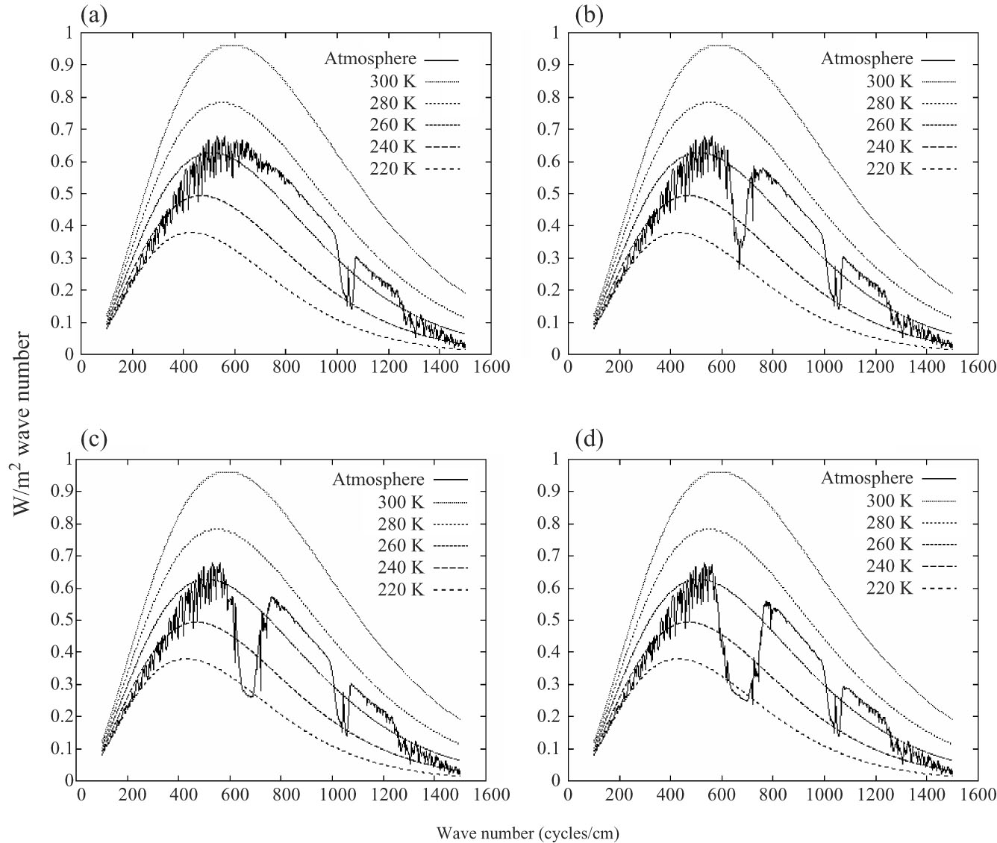
Carbon Dioxide Band Saturation
Figure 4.5
Atm w/no CO2
Atm w/10 ppm CO2
Atm w/100 ppm CO2
Atm w/1000 ppm CO2

Slide 38
Band Saturation - Figure 4.5
Current CO2 is ~400+ ppm
Figure goes from 0 to 1000 ppm
A. atm transparent to IR at 700 (no CO2)
B. Add 10 ppm has noticeable change.
C. and D. inc. of 100 and 1000 more subtle effect.

Slide 39
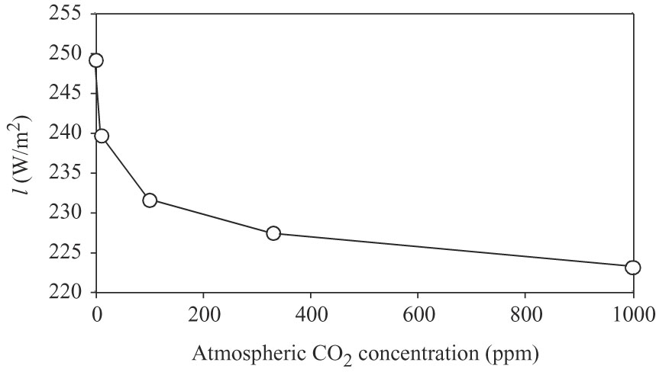
That’s what figure 4.6 is showing
You start to get less bang for your buck as you get to higher concentrations.

Slide 40
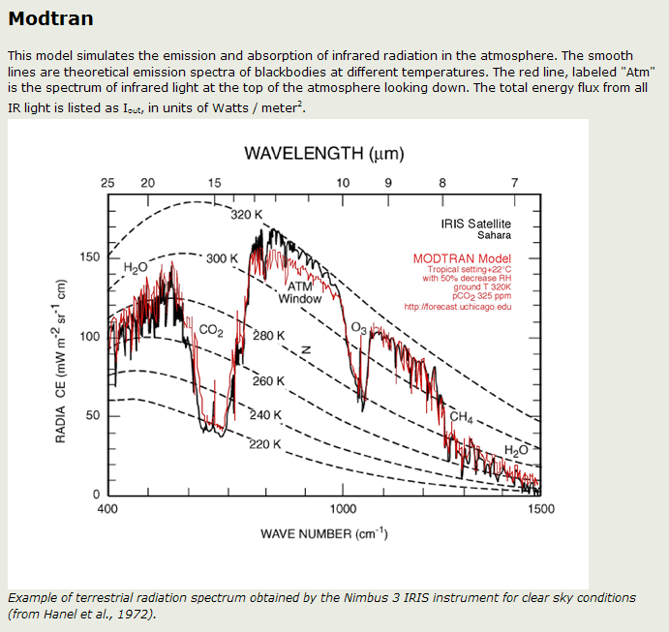
Assignment #2
16.6 - 14μm

Slide 41

Methane & CO2
The band saturation for CO2 means that it is a less potent gh gas than methane.
Even though;
Methane absorbs in the tail
CO2 is under the curve
Methane has a much lower concentration in the atm.
Methane absorption band not saturated.
A molecule of CH4 is 20x
More powerful then a molecule
of CO2

Slide 42
What determines the Earth’s surface temperature?
Greenhouse warming is caused by
Water (H₂O)
Carbon Dioxide (CO₂)
Notes:
They comprise less than 1% of the atmosphere
But they cause nearly all the global warming!

Slide 43
What determines the Earth’s surface temperature?
What is special about H₂O and CO₂?
Their molecules have three atoms,
Their natural frequencies of vibration are in the infra-red,
They are the earth’s blanket for reflecting certain infra-red frequencies back down to earth.
Notes:
1000 Watts per square metre at the Equator:
At - 18°C there would be no water and probably no life (although internal heat sources in the Earth might provide a reservoir for life)

Slide 44
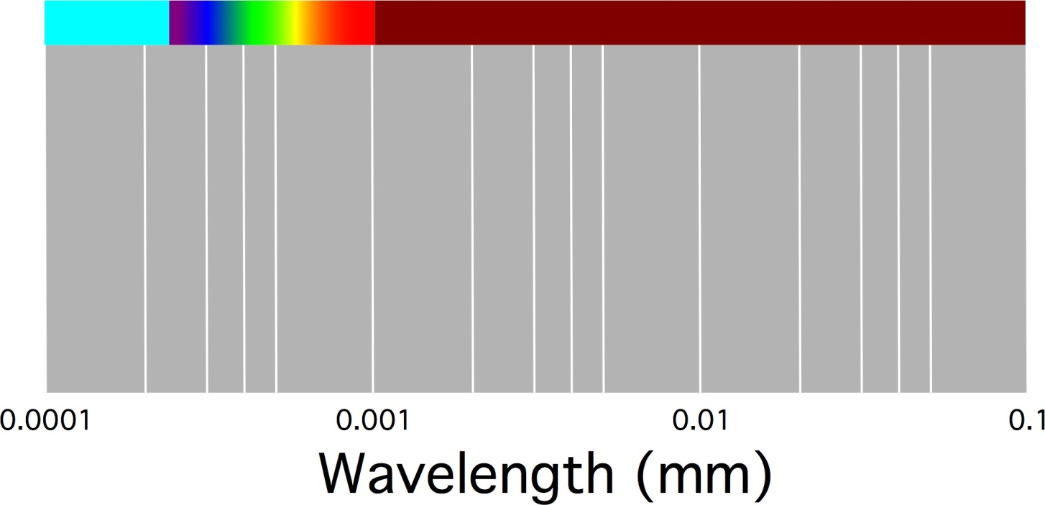
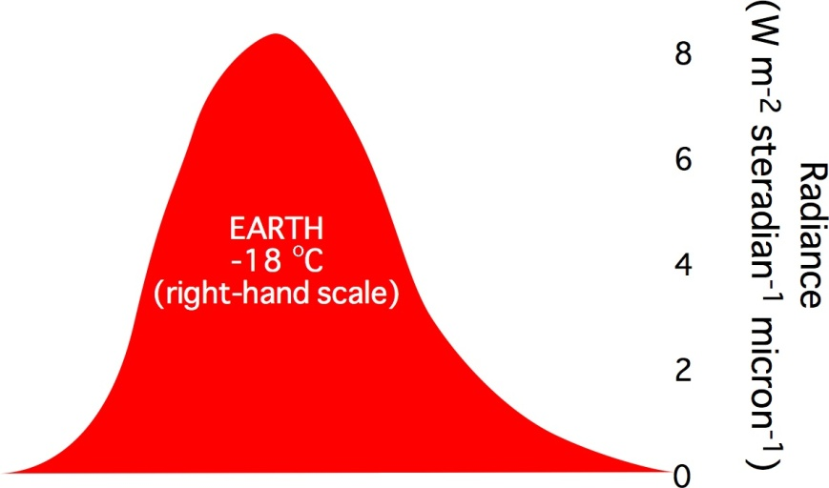

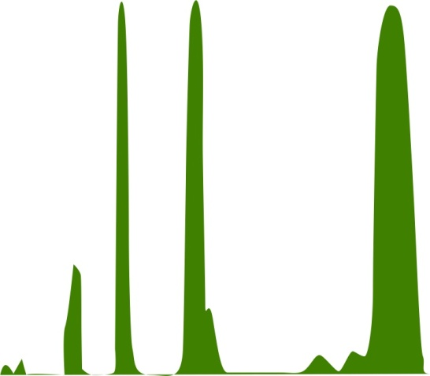
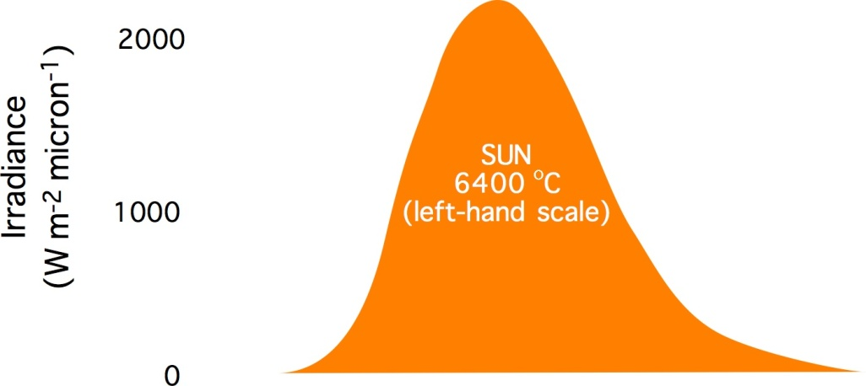
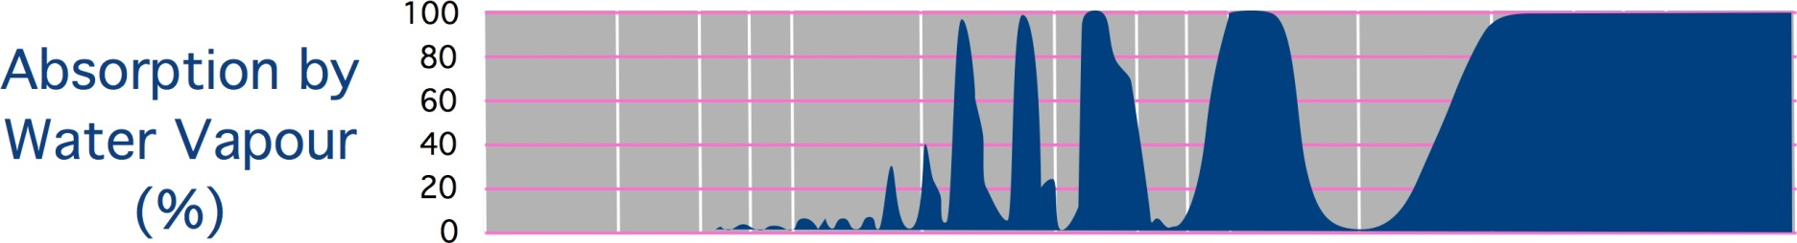
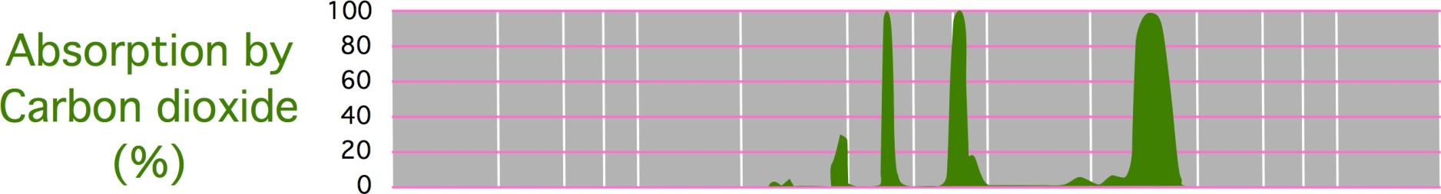
Infrared Radiation absorbed by Water and CO₂
Ultra Violet
Visible
Infra Red
Notes:
Inspired by a figure in the Australian Meteorological Office
The sun’s energy is emitted mainly in the visible.
The energy from the earth’s surface is emitted in the infra red.
Note: the comparative output of the earth and the sun.
Water absorbs much
Carbon dioxide absorbs different wavelengths.
Questions of the diagram

Slide 45
What determines the Earth’s surface temperature?
+15ºC
CO₂
Greenhouse Warming
33 °C
H₂O
–18ºC
Notes:
http://www.geographyhigh.connectfree.co.uk/geographyhighstevensonsc.html

